Slide 1


Presentation on Internship
Prepared By :
Vaghasiya Archana (12108102)
Gehlot Manthan (12108124)

Slide 2

Odoo India
Address:
401 & 402, Floor 4,
IT Tower 3 InfoCity Gate,
1, Gandhinagar, Gujarat 382007

Slide 3
Odoo India
Odoo is a suite of open source business apps that cover all your company needs: CRM, eCommerce, accounting, inventory, point of sale, project management, etc.
Odoo is a Belgian suite of business management software tools including, for example, CRM, e-commerce, billing, accounting, manufacturing, warehouse, project management, and inventory management.
Between the Odoo apps and the tens of thousands of Community apps, there is something to help address all of your business needs in a single, cost-effective and modular solution: no more work to get different technology cooperating.
Odoo apps are perfectly integrated with each other, allowing you to fully automate your business processes and reap the savings and benefits.

Slide 4
History
In 2005, Fabien Pinckaers, the founder and current CEO of Odoo, started to develop his first software product, TinyERP. Three years later, the name was changed to OpenERP. The company started to grow quickly and in 2010, OpenERP had become a 100+ employee company.
In 2013, the company won a Deloitte award for being the fastest-growing company in Belgium, with 1549% growth over a five-year period.
In 2014, the company was renamed Odoo, to diversify itself from the term "ERP".[15] In 2015, Inc. Magazine placed Odoo in the top 5000 fastest-growing private companies in Europe,In 2019, the company raised a $90 million investment.
In 2021, Odoo products were used by more than 5 million customers.Odoo expects to hire 1,000 new employees, according to CEO Fabien Pinckaers.

Slide 5
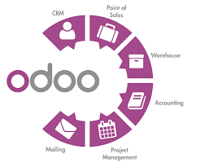
Initial release date:
February 2005
Developer:
Odoo SA
License:
"Community" version: GNU Lesser General Public License v3;
"Enterprise" version: Proprietary license
Repository:
github.com/odoo/odoo
Operating system:
Linux, Unix-like, OS X, Windows, iOS, Android
Preview release:
master
Programming languages:
Python, JavaScript

Slide 6
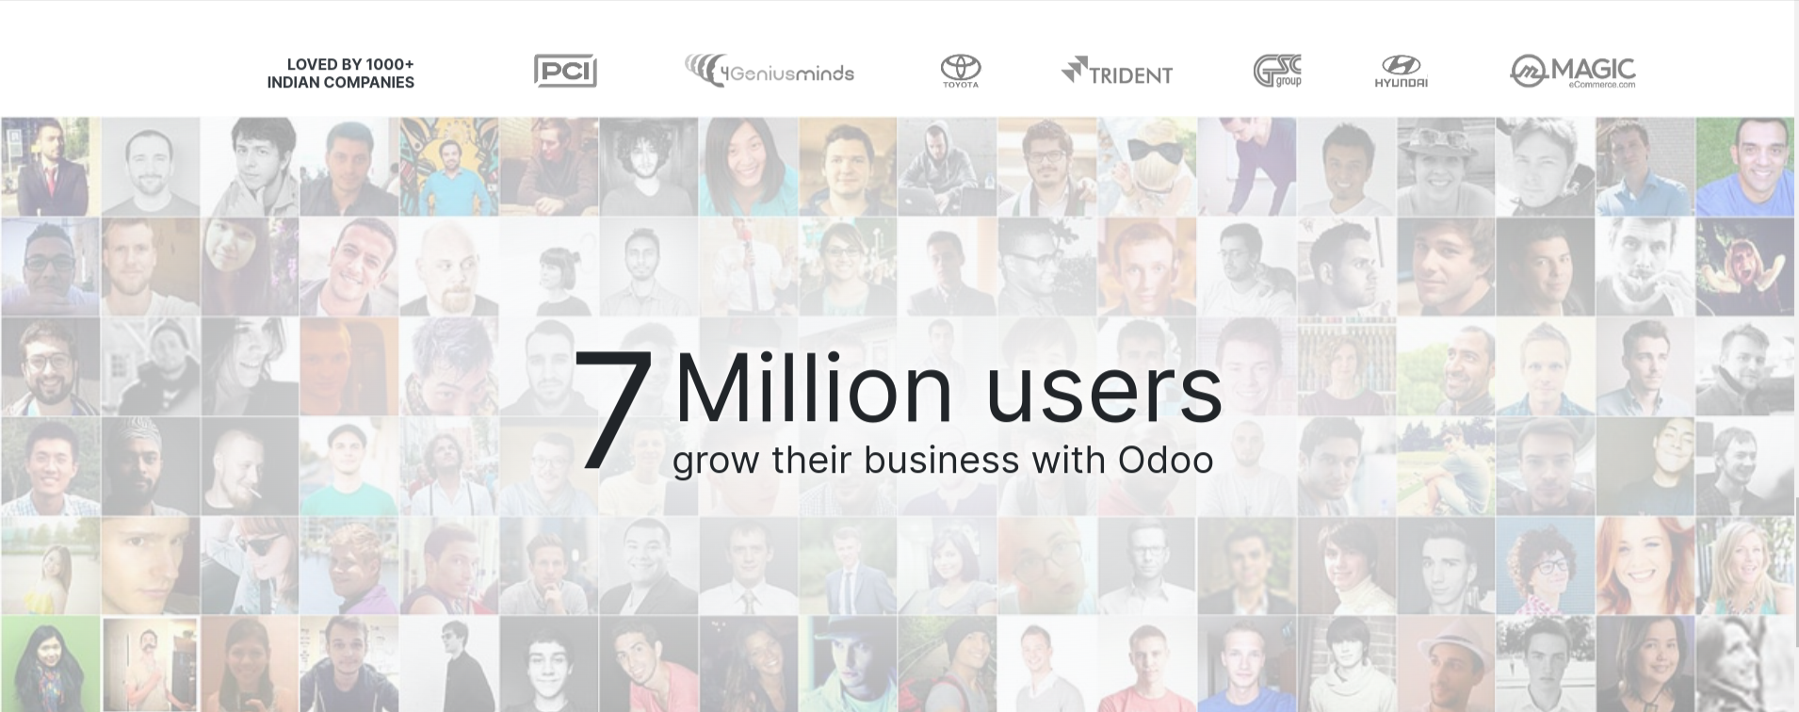

Slide 7
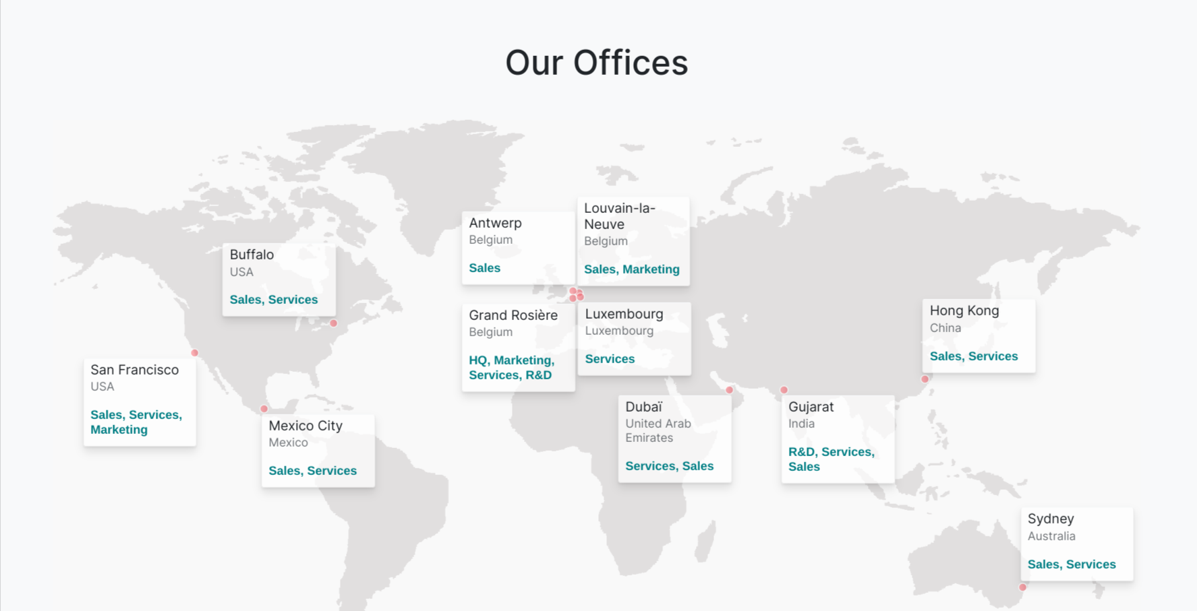

Slide 8
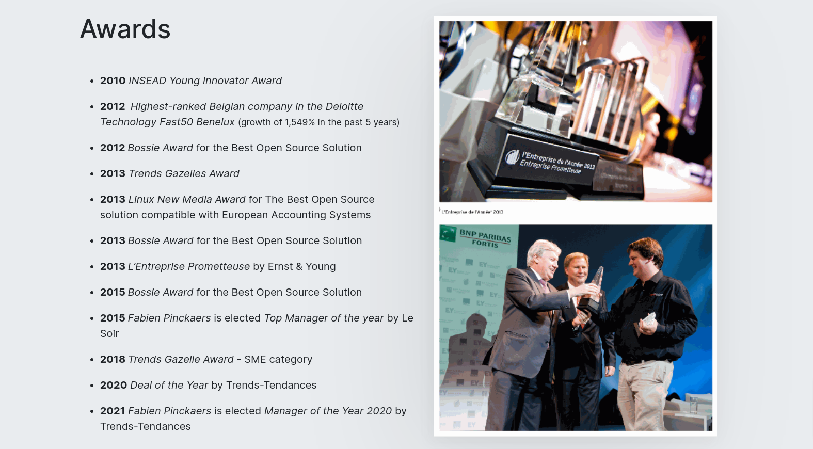

Slide 9
Open Source
Open Source is a great development model! But it’s not a business model.To build a sustainable solution, we use an open core business model, based on two products:
1. Odoo Community :- our open source product that covers most management needs: CRM, Sales, Invoicing, MRP, Website, etc.
2. Odoo Enterprise :- a subscription to get extra features (Accounting, Studio, Timesheet, etc) and services (upgrades, support, Odoo.sh).

Slide 10
Odoo Update
As the name denotes, it is switching over from Odoo 14 to the latest Odoo 16. Keep in mind that it does not change the edition from community to enterprise editions, and it also does not cover the hosting type or migration from enterprise software to Odoo.
As discussed, an updated version gives you more ease of use, better options, and better technical support for doing complicated tasks. An updated version also gives you timely alerts on other newer additions, better workflow, and options for availing of other premium services for Odoo customization.

Slide 11
ORGANIZATION
Departments in Odoo:
Sales
Research & Development
Upgrade
Development on demand

Slide 12
Sales
In Sales, you’re either a hunter or a farmer: the former negotiate and sign new customers (Business Advisors, Partnership Recruitment), the latter build and nurture long-term business relationships with partners (Account Manager) or clients (Customer Success Team "CST"). For the ambitious ones who want to work with the big guys, our Mid-market & Corporate team will suit you just fine.
Sales are superman/women; they do demos, understand the business, find tailored solutions to pain points, negotiate contracts, etc. The direct sales are business advisors, more than salesmen (no outbound sales).

Slide 13

Research & Development
The R&D department works at the core of the product development. Each team has different responsibilities; a set of apps, frontend framework (JS), backend (Python), IA, mobile apps, etc.
There is no planning, no budget, no boring managers: just smart engineers and great technology

Slide 14
Deveopment on demand
We have proven the offshore methodology to be successful for any project development, as long as it's combined with the right project management.
you will be responsible for creating and customizing Odoo modules, developing and implementing features.
Create and customize Odoo modules based on our business needs.
Develop and implement new features and functionalities in Odoo.
Troubleshoot and debug any issues with our Odoo installation.

Slide 15
Deveopment on demand
We have proven the offshore methodology to be successful for any project development, as long as it's combined with the right project management.
you will be responsible for creating and customizing Odoo modules, developing and implementing features.
Create and customize Odoo modules based on our business needs.
Develop and implement new features and functionalities in Odoo.
Troubleshoot and debug any issues with our Odoo installation.

Slide 16
Intenrship Experience at R&D
(12108102)
Odoo Training:
Training Duration: - 2 Months
Module :- Real Estate Advertisement Module
Description :-
In the training, we worked on the module “Real Estate Advertisement Module”.
In which we added the functionality such as – property offer, property tags, property types.

Slide 17
We used languages such as – python, xml and javascript and for the database we used postgresql.
We have also added the functionality to generate the invoice of the sold property and also to download it’s pdf report.
After odoo training i completed my functional and technical training.

Slide 18
Current Working Experince.
After completing the training, I am currently working in the sentry team of the R&D department.
Currently we have 20 people working in our team.
SENTRY :
Sentry is a team in R&D department in odoo which uses the sentry platform.
Sentry is crash reporting platform that provides you with “real-time insight into production deployments with info to reproduce and fix crashes”.

Slide 19
It is third party software used by odoo.
Sentry has support for Javascript, React, Node, Python, PHP, Ruby, Java and other programming languages.
In odoo, sentry report the errors (trace back) that occurred in the user’s database.
And our team try to generate the same error by information provided by sentry and fix them.
Basically, team sentry fixes all the bugs that has come in the user’s database.

Slide 20
I was fortunate enough to work under the direct mentorship of our sentry team leadeer : bhaumik sir who was not only kind and knowledgeable but also knew how to teach a trainee of an internship program.
Problems can be difficult to solve on your own. That’s why working together as a team can offer quicker and often more effective solutions.

